Slide 1

Dataflow Level
باسمه تعالی
احسان یزدیان
زمستان 1403

Slide 2
Levels of Abstraction in Verilog
سطوح مختلف توصیف سخت افزار
سطح توصیف رفتاری :Behavioral (algorithmic) level
سطح انتقال داده: Dataflow level
سطح گیت: Gate level
Continuous assignment
Realized as connection or wire in the design
The assign keyword
module my_and(output out, input in1, in2);
....
assign out = in1 & in2;
....
endmodule

Slide 3
Continuous assignments انتساب پیوسته
Used for Combinational Logic Implementation
All assign statements operate concurrently.
Syntax: assign LHS = RHS;
The left hand side, LHS, must be a wire.
The right hand side, RHS, may be a wire, a reg, a constant, or expressions with operators using one or more wires, regs, and constants.
Two types of continuous assignments:
Explicit Continuous Assignment
Implicit Continuous Assignment
Recommendation : Use Explicit Continuous Assignment to make your code more readable
wire x;
assign x=in1|in2;
//the same as:
wire x=in1|in2;

Slide 4
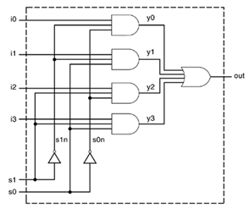
Gate Level vs. Dataflow Modeling
Gate Level Model
module mux4_to_1 (output out, input i0, i1, i2, i3, s1, s0);
wire s1n, s0n, y0;
Wire y1, y2, y3;
not not1(s1n,s1);
not not2(s0n,s0);
and and1(y0,i0,s1n,s0n);
and and2(y1,i1,s1n,s0);
and and3(y2,i2,s1, s0n);
and and4(y3,i3,s1, s0);
or or1(out,y0,y1,y2,y3);
endmodule
Dataflow Model
module mux4_to_1 (output out, input i0, i1, i2, i3, s1, s0);
wire y0,y1,y2,y3;
assign y0 = ~s1 & ~s0 & i0;
assign y1 = ~s1 & s0 & i1; assign y2 = s1 & ~s0 & i2;
assign y3 = s1 & s0 & i3;
assign out = y0|y1|y2|y3;
endmodule
Could be combined in a single statement

Slide 5
Operators
Operators in Verilog are similar to operators you might find in other programming languages.
Operator category | Operators symbol
Arithmetic | * / + -% **
Logical | ! && ||
Relational | > < <= >=
Equality | == != === !===
Bitwise | ~ & | ^ ^~ ~^
Reduction | & ~& | ~| ^ ~^ ^~
Shift | >> << >>> <<<
Concatenation | { }
Replication | { { } }
Conditional | ? :

Slide 6
Operators
Arithmetic operators:
+ Addition.
- Subtraction
* Multiplication
/ Division (Truncates fractional part).
% Modulus (Remainder from division of two numbers)
** Power (raises e to the power f)
Examples:
wire [4:0] a,b,c,d; //evaluates to 1
assign b= -7 % 2; //evaluates to -1, takes sign of first operand
assign c= -7 / 2; //evaluates to -3
assign d= b+c*a;
Be careful of width of the output number.
Sum: May add one bit
Multiply: Width of output may be sum of the width of input numbers.
Examples:
wire [7:0] a, b;
wire [8:0] sum;
assign sum=a+b;
reg [5:0] a,b;
wire [11:0] mult;
assign mult=a*b;

Slide 7
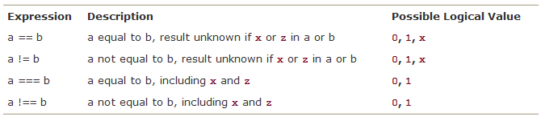
Operators
relational operators: (output values: 0,1,x)
> Greater than.
< Less than.
>= Greater than or equal.
<= Less than or equal.
Dyadic comparison operators:
== Equality operator ( z, x are invalid).
=== Identity operator (z, x are valid).
!= Not equal.
!== Not identical.
Examples:
a = 2'b10, b = 2'b1x, c = 2'b1z
a == b a === b b == 2’b1x b !== c
(x) (0) (x) (1)

Slide 8
Operators
Operation | Result
4’b1010 && 4’b1100 | 1
2’b11 || 2’b00 | 1
!(4’b0010) | 0
2’b1X && 2’b11 | x
Logical operators:
&& Binary logical AND.
|| Binary logical OR.
Non‐zero operand=logical “1”
Any X/Z operand Z, result is X
shift operators:
<< Shift left.
>> Shift right.
A=6’b001100
Arithmetic Shift: (<<<,>>>)
arithmetic right shift (>>>)
Shift right specified number of bits, with value of sign bit if expression is signed, othewise all with zero.
assign A=$signed(test1) >>> 1 ; // test1 is not a signed number
assign test3= test2 >>> 1 ; // test2 as signed type
Operation | Result
B = A >> 1 | B = 6’b000110
C = A << 2 | C = 6’b110000
D = A >> 3 | D = 6’b000001

Slide 9
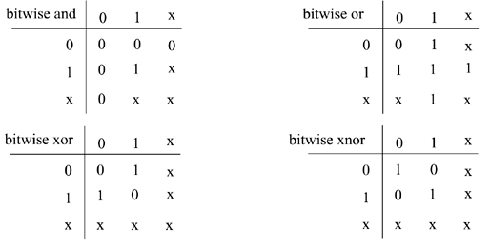
Operators
Bit-wise operators:
& Bit-wise logical AND.
| Bit-wise logical OR.
^ Bit-wise logical XOR.
~^ Bit-wise logical XNOR.
~ Bit-wise negation
Bitwise vs. Logical operators
Bit-width mismatch issue
Operation | Result
1010 & 1100 | 1000
1010 | 1100 | 1110
~1010 | 0101
1101 ^ 0100 | 1001

Slide 10
Operators
Concatenation.
A = 1'b1;
B = 2'b00;
assign {carry,sum}=a+b+c_in;
wire [7:0] a, shifted_a;
assign shifted_a={a[0],a[7:1]};
Replication.
Operation | Result
{A,B} | 3’b100
{B,A,B} | 5’b00100
{A,3’b001,B} | 6’b100100
Operation | Result
{3{A},B} | 5’b11100
{3{B},2{A}} | 8’b00000011
{{3{A}}, 2’b01,{2{B}}} | 9’b111010000

Slide 11
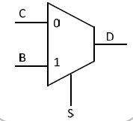
Conditional Operator
Conditional Operator
assign D = S ? B:C;
D = B if S=1
D = C if S=0;
A simple Example
reg [7:0] a;
wire [3:0] out;
wire control;
assign out = (control==1’b1) ? a[3:0] : a[7:4];
// the above line can be replaced with the following
//assign out = (control) ? a[3:0] : a[7:4];

Slide 12
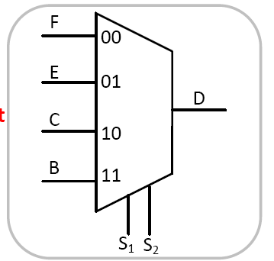
Example : Bus Mux
module 4_input_mux (E, B, C, F, S1, S2 , D);
input [3:0] E,B,C,F;
input S1, S2;
output[3:0] D;
assign D = ({S1,S2}==2’b00)? F:
({S1,S2}==2’b01)? E:
({S1,S2}==2’b10)? C:B;
endmodule

Slide 13
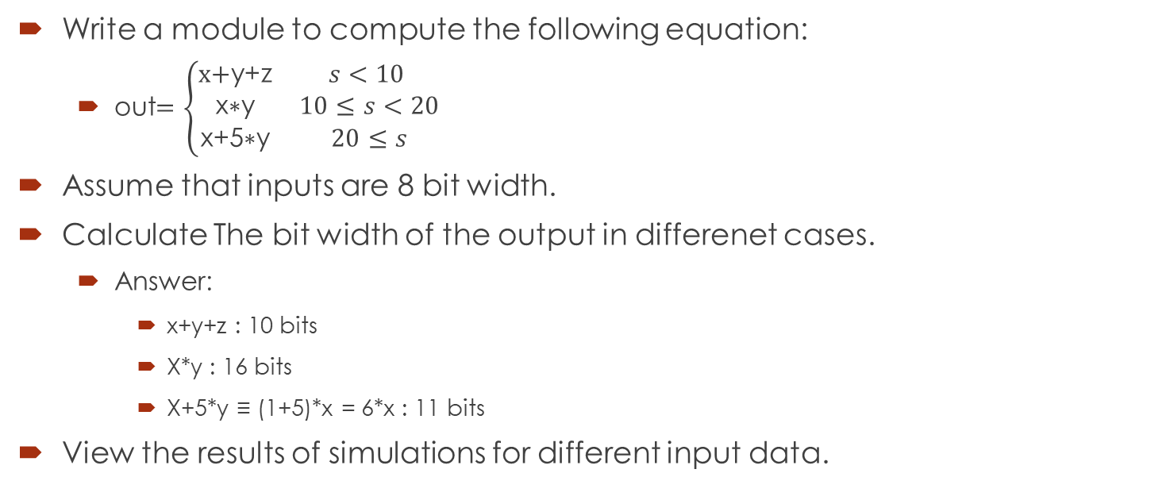
Example Design In Dataflow Level
Write a module to compute the following equation:
out$=\left\{\begin{matrix}\text{x}\text{+}\text{y}\text{+}\text{z} & s<10 \\ \text{x}\text{∗}\text{y} & 10≤s<20 \\ \text{x}\text{+}\text{5}\text{∗}\text{y} & 20≤s\end{matrix}\right.$
Assume that inputs are 8 bit width.
Calculate The bit width of the output in differenet cases.
Answer:
x+y+z : 10 bits
X*y : 16 bits
X+5*y ≡ (1+5)*x = 6*x : 11 bits
View the results of simulations for different input data.

Slide 14
Modeling real hardware delays in Verilog
In real circuits, logic gates have delays associated with them, represent two different physical concepts:
The RC circuit seen at the node
propagation delays of electrical elements
Modeling hardware delays are very important in REAL simulations:
Post-synthesis simulation
Post-route simulation
Verilog provides the mechanism to associate delays with gates.
Rise, Fall and Turn-off delays.

Slide 15
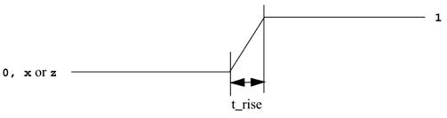
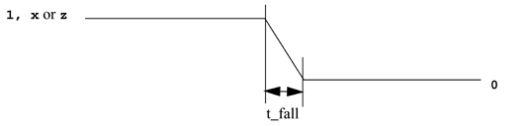
Delay Types
Rise Delay
output transition to 1 from another value (0, x, z).
Fall Delay
output transition to 0 from another value (1, x, z).
Turn-Off Delay
Associated with a gate output transition to z from another value (0, 1, x).

Slide 16
Delays in Gate-Level Modeling
Delay are shown by # sign in all verilog modeling levels
Delay of delay_time for all transitions
and #(delay_time) a1(out, i1, i2);
Rise and Fall Delay Specification
Turn-off delay is the minimum of the two
and #(rise_val, fall_val) a2(out, i1, i2);
Rise, Fall, and Turn-off Delay Specification
and #(rise_val, fall_val, turnoff_val) b1 (out, in, control);
Examples:
xor #(3) a(out,in1, in2)
or #(3,4) a(out,in1, in2)
and #(3, 4, 5) a(out,in1, in2)

Slide 17
Delays in Dataflow Modeling
Regular Assignment Delay
assign #10 out1 = in1 ^ in2;
assign #(10,8) out2 = in1 & in2;
Net Declaration Delay
wire #2 out;
assign #5 out = in1 & in2;
2 time unit delay on wire out
5 time units of delay for AND gate
Any change in in1 or in2 reflects on out after 7 time unit delay

Slide 18
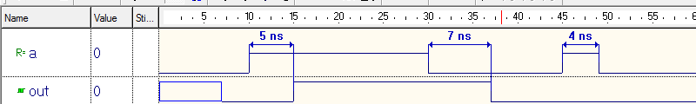
Example
assign #(5,7,1) out=(a==1);
// Delay in a continuous assign
A pulse of width less than the specified assignment delay is not propagated to the output.
Observing the results on ModelSim and ISIM.

Slide 19
Min/Typ/Max Delays
Min/Typ/Max Values
Another level of delay control in Verilog
Each of rise/fall/turnoff delays can have min/typ/max values
not #(min:typ:max, min:typ:max, min:typ:max) n(out,in)
Example:
xor #(1:4:8,4:5:6) xor_inst (out,a,b);
Only one of Min/Typ/Max values can be used in the entire simulation run
It is specified at start of simulation, and depends to the simulator used
ModelSim> vsim +mindelays.
ModelSim> vsim +typdelays.
ModelSim> vsim +maxdelays.
Typ delay is the default

Slide 20
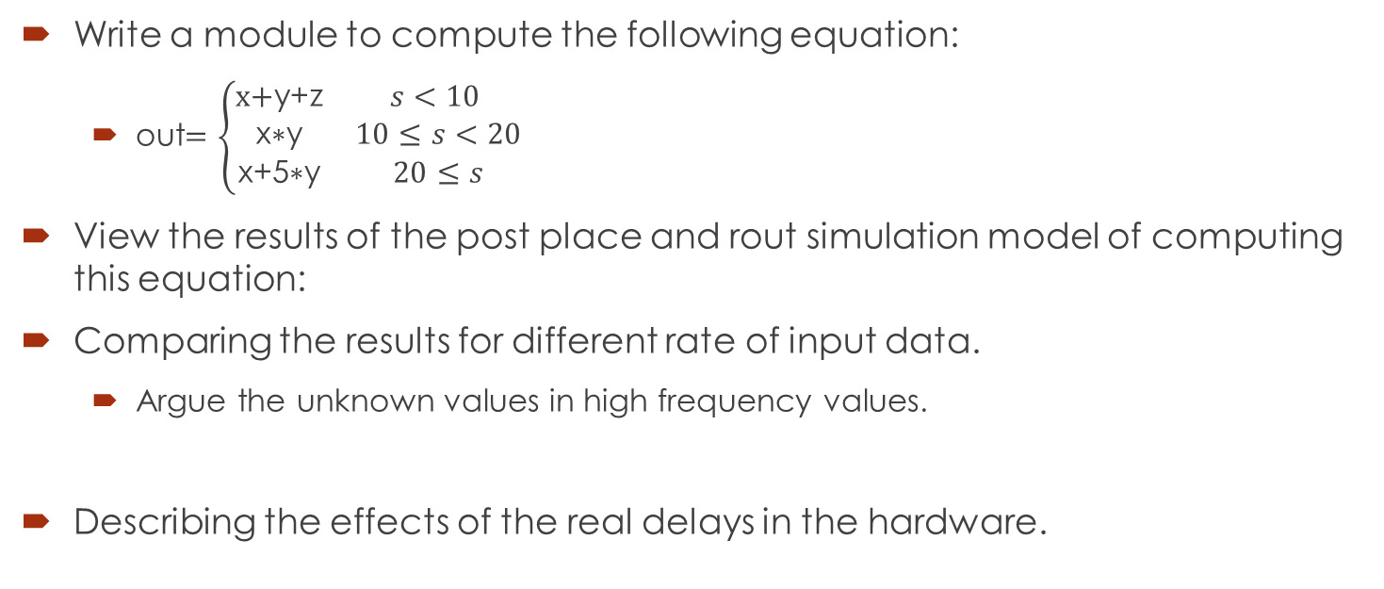
Example Design In Dataflow Level
Write a module to compute the following equation:
out$=\left\{\begin{matrix}\text{x}\text{+}\text{y}\text{+}\text{z} & s<10 \\ \text{x}\text{∗}\text{y} & 10≤s<20 \\ \text{x}\text{+}\text{5}\text{∗}\text{y} & 20≤s\end{matrix}\right.$
View the results of the post place and rout simulation model of computing this equation:
Comparing the results for different rate of input data.
Argue the unknown values in high frequency values.
Describing the effects of the real delays in the hardware.

Slide 21
…. Back to FPGA structure
Look-Up Tables
FPGA uses SRAM memory instead of Combinatorial logic.
Capacity is limited by the number of inputs, not by the complexity
Benefits:
Delay through the LUT is constant
It is simpler to design.
LUT
A
B
Z
C
D
A | B | C | D | Z
0 | 0 | 0 | 0 | 0
0 | 0 | 0 | 1 | 0
0 | 0 | 1 | 0 | 0
0 | 0 | 1 | 1 | 1
0 | 1 | 0 | 0 | 1
0 | 1 | 0 | 1 | 1
 | . | . | .
1 | 1 | 0 | 0 | 0
1 | 1 | 0 | 1 | 0
1 | 1 | 1 | 0 | 0
1 | 1 | 1 | 1 | 1
Combinatorial Logic
A
B
Z
C
D

Slide 22
Basic Components of FPGA
Simplified Slice Structure
Flip-Flops are used to implement sequential logics.
LUT
LUT
A typical Slice in 3 Series FPGAs
LUT
LUT
Carry
PRE
D
Q
CE
CLR
LUT
0 1
LUT
Carry
A typical Slice in 7 Series FPGAs
D
PRE
Q
CE
CLR
Notes:
The major parts of a slice include two Look-Up Tables (LUTs), two sequential elements, and carry logic.
The LUTs are known as the F LUT and the G LUT. The sequential elements can be programmed to be either registers or latches.
The next several slides cover the LUT, the carry logic, and the flip-flops in detail.

Slide 23
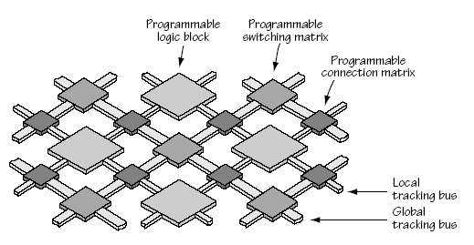
Connecting Look-Up Tables
FPGA has Large Number of CLBs (Configurable Logic block) and Interconnections.
Local routing provides feedback between slices in the same CLB, and it provides routing to neighboring CLBs
A typical CLB
Switch
Matrix
COUT
COUT
Slice S3
Slice S2
SHIFT
Slice S1
Slice S0
CIN
CIN
Local Routing
Notes:
Look-Up Tables (LUTs) are also called Function Generators (FGs).

Slide 24
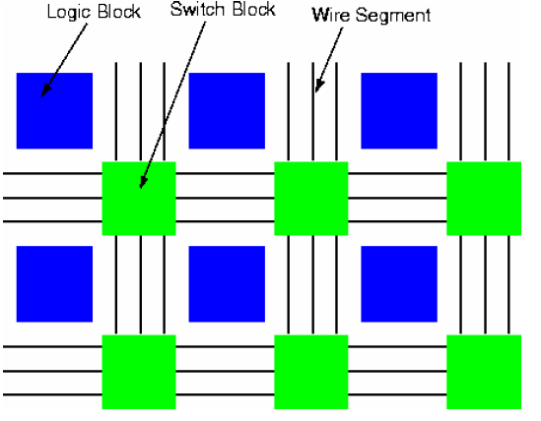
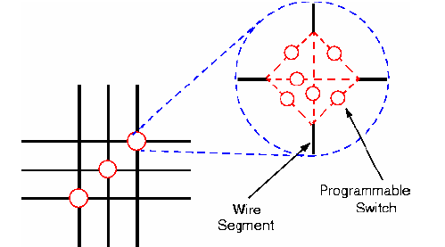
CLB Inteconnections
Connections between CLBs and other resources use the fabric routing resources
Routing lines connect to the switch matrixes adjacent to the resources
A switch matrix provides access to general routing resources
The mapping of logical connections to these physical routing resources is entirely managed by the router software.

Slide 25
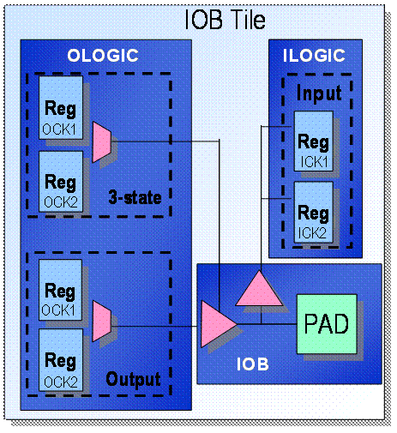
FPGA Structure
Basic components
Configurable Logic (CLBs)
Contain combinatorial logic and register resources
Programmable Interconnection
Programmable Input/Output circuit
Interface between the FPGA and the outside world
Each I/O supports 40+ voltage and protocol standards, including
LVCMOS, LVDS, LVPECL, SSTL, HSTL, …
Each pin can be input, output and 3-state.
Each pin can be individually configured.

Slide 26
FPGA Structure
Programmable Clock Generator
Global clock buffers
Macro components
Multiplier ( large combinational logic)
Random Access Memory (Large Density)
Read Only memory (Large Density)
CPU
Rocket IO
DSP blocks

Slide 27
FPGA Structure (Common Blocks)
Block SelectRAM™
resource
I/O Blocks (IOBs)
Programmable interconnect
Dedicated multipliers
Configurable
Logic Blocks (CLBs)
Clock Management

Slide 28
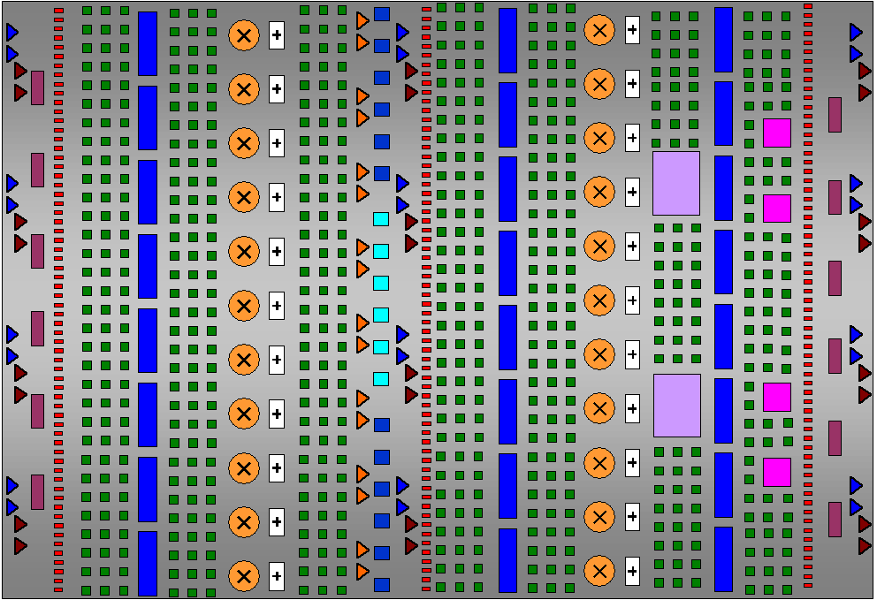
Some New Features
RocketIO™ Multi-Gigabit
Transceivers 622 Mbps–10.3 Gbps
Smart RAM
New block RAM/FIFO
Xesium Clocking Technology
500 MHz
Advanced CLBs 200K Logic Cells
Tri-Mode
Ethernet MAC 10/100/1000 Mbps
XtremeDSP™ Technology Slices 256 18x18 GMACs
PowerPC™ 405
with APU Interface 450 MHz, 680 DMIPS
1 Gbps SelectIO™ ChipSync™ Source synch, XCITE Active Termination

Slide 29
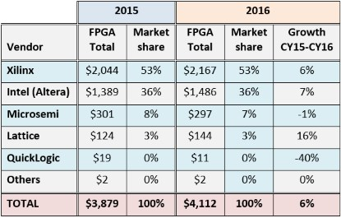
FPGA Vendors
Xilinx, Inc.
SoC (System on Chips: ARM+FPGA): Zynq
High Performance
Virtex: Virtex7, Virtex6, ….
Low Cost
Kintex
Artix
Spartan: Spartan6, Spartan3, Spartan2, Spartan
Altera Corp.
Stratix
Arria
Cyclone
Lattice
Atmel
Flash and Antifuse based:
Altera (MAX-II)
Actel Corp.
Quick Logic Corp.
Share over 89% of the market. (2016)
Incomes are in million$

Slide 30


Xilinx vs. Altera
Founded | 1984; 33 years ago
Key people | Dennis Segers Chairman of the Board Moshe N. Gavrielov President CEO Director
Products | FPGAs, CPLDs
Revenue | US$ 3.06 billion (2019) US$ 2.213 billion (2016)
Operating income | US$745.054 million (2018) US$ 669.881 million (2016)
Net income | US$ 622.512 million (2017) US$ 550.867 million (2016)
Total assets | US$ 4.740 billion (2017) US$ 4.819 billion (2016)
Number of employees | 4,014 - (June 2018)
Founded | 1983, 34 years ago
Key people | John Daane (CEO) Dan McNamara (Intel PSG leader)
Products | FPGAs, CPLDs, Embedded Processors, ASICs
Revenue | US$ 1.783 billion (2013)
Operating income | US$584.1 million (2013)
Net income | US$556.8 million (2013)
Total assets | US$4.658 billion (2013)
Total equity | US$3.333 billion (2013)
Number of employees | 2,884 (December 2011)
Parent: Intel داده ها قدیمی است چون عملا پس از خریده شدن توسط Intel آمار جداگانه ای از این شرکت نیست.

Slide 31
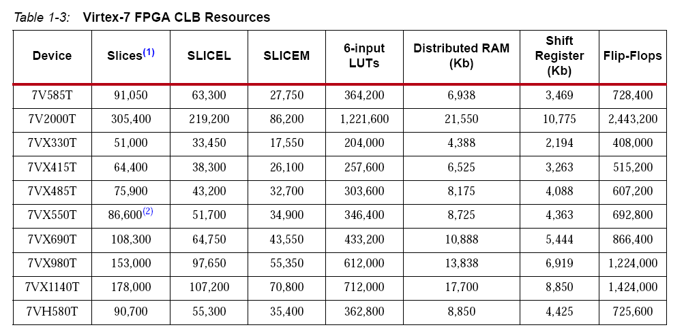
Example of resources on Virtex-7
Each 7 series FPGA slice contains four LUTs and eight flip-flops;
Two types of slices:
SLICEM: Full slice
LUT can be used for logic and memory/SRL
SLICEL: Logic and arithmetic only (not memory)

